Slide 1
Angular - Routing,Http Services

Slide 2
Routing
Routing basically means navigating between pages.
You have seen many sites with links that direct you to a new page.
This can be achieved using routing. Here the pages that we are referring to will be in the form of components.

Slide 3
app.sqrt.ts
import {Pipe, PipeTransform} from '@angular/core';
@Pipe ({
name : 'sqrt'
})
export class SqrtPipe implements PipeTransform {
transform(val : number) : number {
return Math.sqrt(val);
}
}

Slide 4
app.module.ts
import { BrowserModule } from '@angular/platform-browser';
import { NgModule } from '@angular/core';
import { RouterModule} from '@angular/router';
import { AppComponent } from './app.component';
import { NewCmpComponent } from './new-cmp/new-cmp.component';
import { ChangeTextDirective } from './change-text.directive';
import { SqrtPipe } from './app.sqrt';
@NgModule({
declarations: [
SqrtPipe,
AppComponent,
NewCmpComponent,
ChangeTextDirective
],
imports: [
BrowserModule,
RouterModule.forRoot([
{
path: 'new-cmp',
component: NewCmpComponent
}
])
],
providers: [],
bootstrap: [AppComponent]
})
export class AppModule { }

Slide 5
New-cmp.component.ts
import { Component, OnInit } from '@angular/core';
@Component({
selector: 'app-new-cmp',
templateUrl: './new-cmp.component.html',
styleUrls: ['./new-cmp.component.css']
})
export class NewCmpComponent implements OnInit {
newcomponent = "Entered in new component created";
constructor() {}
ngOnInit() { }
}

Slide 6
New-cmp.component.html
<p>
{{newcomponent}}
</p>
<p>
new-cmp works!
</p>

Slide 7
app.component.html
<h1>Custom Pipe</h1>
<b>Square root of 25 is: {{25 | sqrt}}</b><br/>
<b>Square root of 729 is: {{729 | sqrt}}</b>
<br />
<br />
<br />
<a routerLink = "new-cmp">New component</a>
<br />
<br/>
<router-outlet></router-outlet>

Slide 8
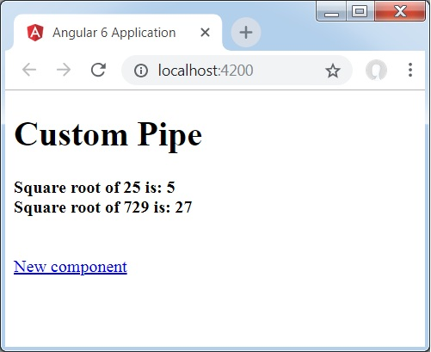

Slide 9
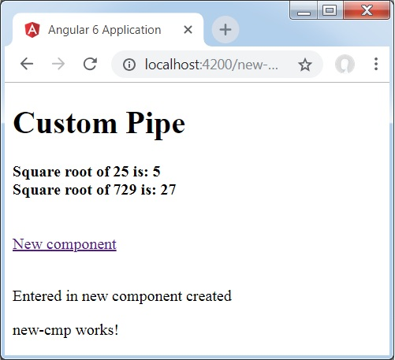

Slide 10
Angular - Http Client

Slide 11
Communicating with backend services using HTTP
Most front-end applications need to communicate with a server over the HTTP protocol, in order to download or upload data and access other back-end services.
Angular provides a client HTTP API for Angular applications, the HttpClient service class in @angular/common/http.
HttpClient will help us fetch external data, post to it, etc. We need to import the http module to make use of the http service.

Slide 12
The HTTP client service offers the following major features.
The ability to request typed response objects.
Streamlined error handling.
Testability features.
Request and response interception.

Slide 13
app.module.ts
import { BrowserModule } from '@angular/platform-browser';
import { NgModule } from '@angular/core';
import { AppRoutingModule , RoutingComponent} from './app-routing.module';
import { AppComponent } from './app.component';
import { NewCmpComponent } from './new-cmp/new-cmp.component';
import { ChangeTextDirective } from './change-text.directive';
import { SqrtPipe } from './app.sqrt';
import { MyserviceService } from './myservice.service';
import { HttpClientModule } from '@angular/common/http';
@NgModule({
declarations: [
SqrtPipe,
AppComponent,
NewCmpComponent,
ChangeTextDirective,
RoutingComponent
],
imports: [
BrowserModule,
AppRoutingModule,
HttpClientModule
],
providers: [MyserviceService],
bootstrap: [AppComponent]
})
export class AppModule { }

Slide 14
myservice.service.ts
import { Injectable } from '@angular/core';
import { HttpClient } from '@angular/common/http';
@Injectable({
providedIn: 'root'
})
export class MyserviceService {
private finaldata = [];
private apiurl = "http://jsonplaceholder.typicode.com/users";
constructor(private http: HttpClient) { }
getData() {
return this.http.get(this.apiurl);
}
}

Slide 15
app.component.ts
import { Component } from '@angular/core';
import { MyserviceService } from './myservice.service';
@Component({
selector: 'app-root',
templateUrl: './app.component.html',
styleUrls: ['./app.component.css']
})
export class AppComponent {
title = 'Angular 7 Project!';
public persondata = [];
constructor(private myservice: MyserviceService) {}
ngOnInit() {
this.myservice.getData().subscribe((data) => {
this.persondata = Array.from(Object.keys(data), k=>data[k]);
console.log(this.persondata);
});
}
}

Slide 16
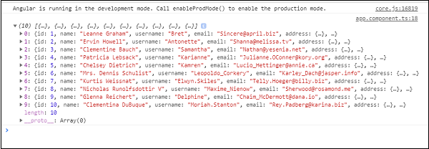

Slide 17
app.component.html
<h3>Users Data</h3>
<ul>
<li *ngFor="let item of persondata; let i = index"<
{{item.name}}
</li>
</ul>

Slide 18
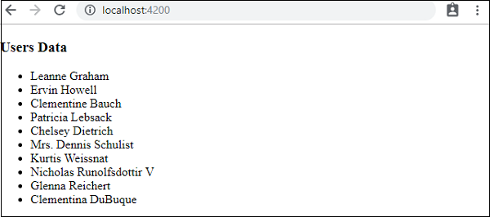

Slide 19


